Slide 1


Project Report on Thought Sync
Comprehensive overview of the project, detailing objectives, methodologies, challenges, and future enhancements.

Slide 2
Literature and Review
Explores the progression of key web development technologies leading to the Reddit clone project.
React.js: Component-based architecture revolutionized frontend development.
GraphQL: Flexible data fetching approach to APIs.
Serverless: Backend-as-a-Service platforms simplified backend development.
TypeScript: Brought static typing to JavaScript, enhancing code quality.
Reddit Clone: Integrated modern technologies for a scalable platform.

Slide 3

Literature Review and Evolution of Web Development Technologies
Rapid evolution of web dev driven by need for efficient, scalable, interactive apps.
Explores progression of key technologies and frameworks for modern web apps.
Culminates in Reddit clone project leveraging cutting-edge tools.

Slide 4
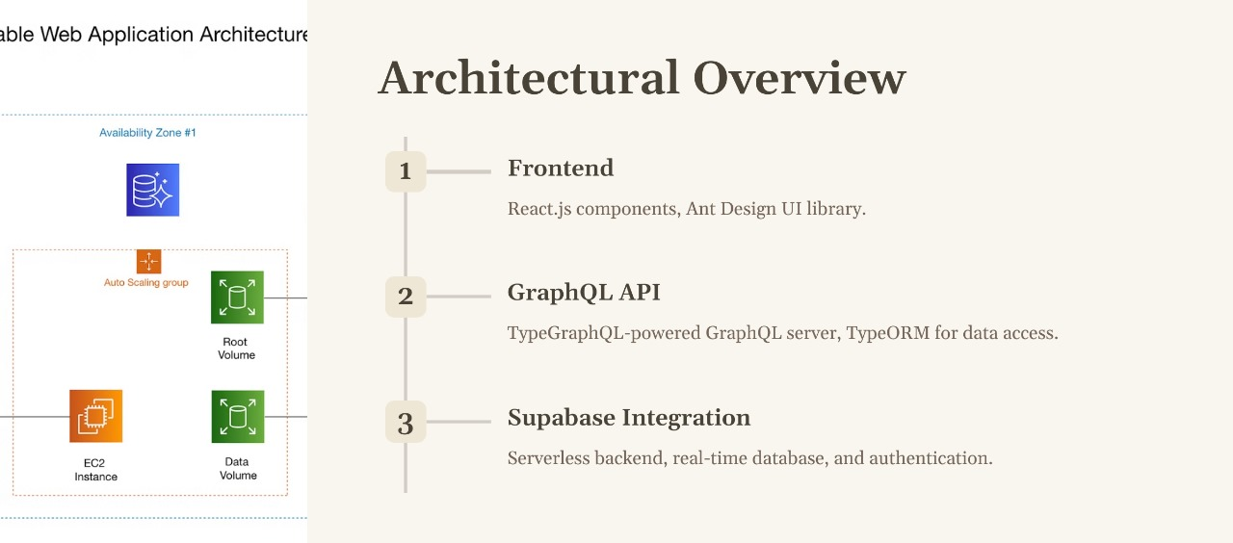

Slide 5
Methodology
Detailed approach to project setup, architecture, visual design, testing, documentation, and user support.
Leveraged modern tools and frameworks for scalable, maintainable development.
Iterative process with continuous feedback and integration for quality assurance.
Comprehensive documentation and automated deployment for consistency.
User training and support channels established for effective platform utilization.

Slide 6
Development Process
Initial Setup
1
Configured dev environment, installed tools and dependencies.
2
Project Planning
Formed team, set up communication and workflows.
Frontend Development
3
Built UI using React.js and Ant Design components.
4
UI Design
Created wireframes, mockups, and prototypes for intuitive UX.
External Integration
5
Integrated Supabase, GraphQL APIs for data and auth.

Slide 7
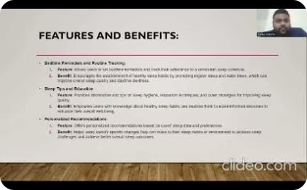
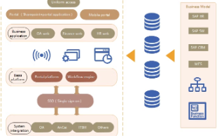
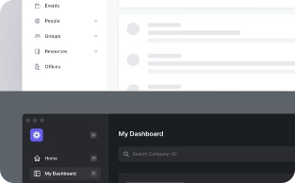
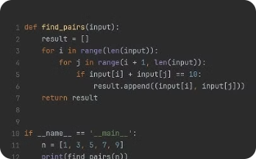
Methodology
Project Setup and Environment
Architecture and Integration
Visual Data Processing
Code Execution Capability
Designed scalable, maintainable architecture.
Designed intuitive, responsive user interface.
Optimized performance and reliability.
Configured dev tools, installed frameworks.

Slide 8
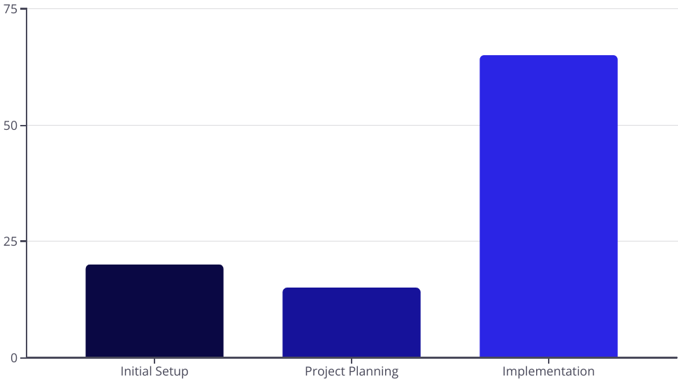
Development Process
Initial Setup and Configuration
Prepared dev environment, installed tools and frameworks.
Project Planning
Formed team, set up communication and workflows.
Implementation
Built UI with React.js and Ant Design, integrated external services.

Slide 9
Results and Discussion
Evaluation Metrics
Performance Metrics
Accuracy Rates
User Satisfaction
Evaluated correctness of data processing.
Assessed overall performance and effectiveness.
Measured speed, responsiveness, and scalability.
Gauged overall user experience through surveys.
Assessed authentication, posting, commenting, voting.
Measured user engagement, content creation, interactions.
Analyzed page load, API response, database queries.
Factors included ease of use, visual appeal, performance.
Qualitative Feedback
Quantitative Feedback
Challenges
Resource Constraints
Identified technical, logistical, and organizational challenges.
Analyzed user opinions, suggestions, and criticisms.
Statistically analyzed user ratings and metrics.
Considered time, budget, and expertise limitations.
Derived insights on satisfaction and strengths/weaknesses.
Categorized by impact and complexity.
Influenced decision-making and project planning.
Identified trends and areas for improvement.

Slide 10
THANK YOU

